Slide 1
Wind Power
& Sustainable Development
Thesis defense
Alessia - Maurits - Sasha - To Van

Slide 2
Introduction
Wind speed data holds the key to unlocking the full potential of renewable energy.
As wind continues to be a reliable and abundant power source :
Accurately predicting wind speed becomes essential for optimizing energy production.
It is leading to more efficient wind farms.
It supports the growing demand for clean power in our quest for a greener future.
Notes:
Project Overview (1 slide):
Brief introduction to your chosen topic and the machine learning problem you’re addressing.
State the objective and potential impact of your project.

Slide 3
Purpose
Our model forecasts windspeed at 50 meters

Slide 4
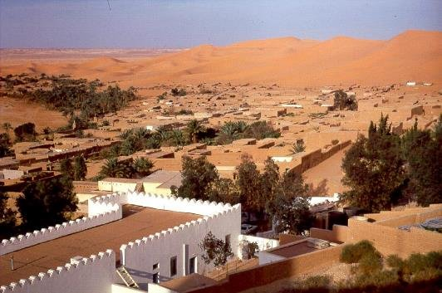

Data Selection and Preparation
Type of data
2 csv data sets :
Adrar in Algeria 70K samples
Tataouine in Tunisia 63K samples
Data collection
Kaggle Data Set
Notes:
Data Selection and Preparation (1 slide):
Describe the dataset(s) used, including sources and any key characteristics.
Highlight the data cleaning and preprocessing steps undertaken to prepare the data for modeling.

Slide 5
Feature Engineering and Selection
Features
Target
Day-of-Year (1 - 365) | INT
Season (1 - 4) | INT
Time in hours (1 - 24) | INT
Temperature in C° | FLOAT
Wind Speed at 10 meters in meter / seconds | FLOAT
Pressure in Pascal | FLOAT
Wind Speed
at 50 meters
in meter / seconds
Notes:
Hyperparameter Tuning and Model Optimization (1 slide):
Explain the hyperparameter tuning techniques employed (e.g., grid search, cross-validation).
Share insights on how these techniques improved your model’s performance.

Slide 6
Feature Engineering and Selection
Features
Target
Day-of-Year (1 - 365) | INT
Season (1 - 4) | INT
Time in hours (1 - 24) | INT
Temperature in C° | FLOAT
Wind Speed at 10 meters in meter / seconds | FLOAT
Pressure in Pascal | FLOAT
Wind Speed
at 50 meters
in meter / seconds
Only numerical datas :
regression problem
Notes:
Hyperparameter Tuning and Model Optimization (1 slide):
Explain the hyperparameter tuning techniques employed (e.g., grid search, cross-validation).
Share insights on how these techniques improved your model’s performance.

Slide 7
Visualising the features
By scatterplot sns.pairplot()
COLUMNS to display:
WS50M - wind speed at 50m PS - pressure Day
WS10M - wind speed at 10m Season Hour
T2M - temperature
Notes:
Hyperparameter Tuning and Model Optimization (1 slide):
Explain the hyperparameter tuning techniques employed (e.g., grid search, cross-validation).
Share insights on how these techniques improved your model’s performance.

Slide 8
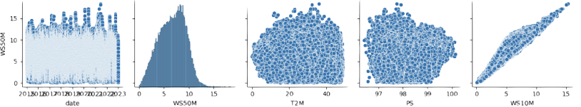
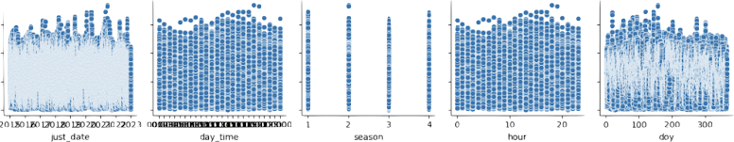
Visualising the features
By scatterplot sns.pairplot()
COLUMNS to display:
WS50M - wind speed at 50m PS - pressure Day
WS10M - wind speed at 10m Season Hour
T2M - temperature
Notes:
Hyperparameter Tuning and Model Optimization (1 slide):
Explain the hyperparameter tuning techniques employed (e.g., grid search, cross-validation).
Share insights on how these techniques improved your model’s performance.

Slide 9
Visualising the features
By scatterplot sns.pairplot()
COLUMNS to display:
WS50M - wind speed at 50m PS - pressure Day
WS10M - wind speed at 10m Season Hour
T2M - temperature
👽
Notes:
Hyperparameter Tuning and Model Optimization (1 slide):
Explain the hyperparameter tuning techniques employed (e.g., grid search, cross-validation).
Share insights on how these techniques improved your model’s performance.

Slide 10
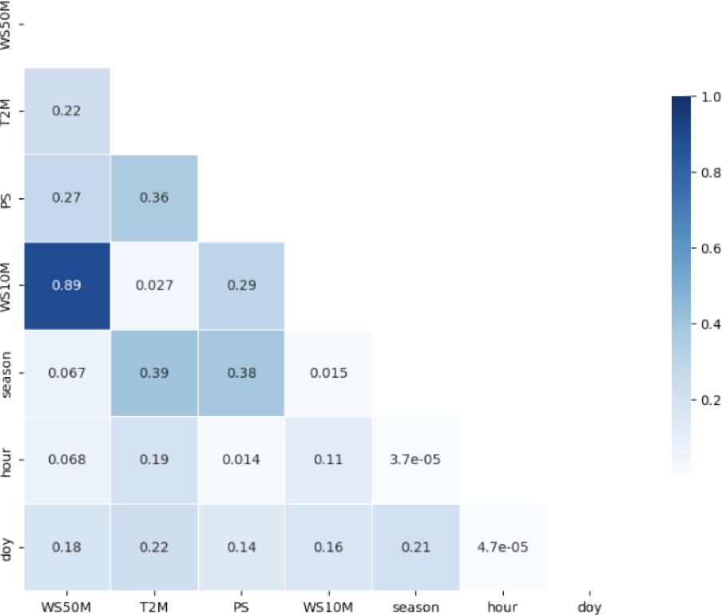
Correlation matrix
Of features sns.heatmap()
Features displayed:
WS10M - wind speed at 10m
T2M - temperature
PS - pressure
season
day
hour
Notes:
Hyperparameter Tuning and Model Optimization (1 slide):
Explain the hyperparameter tuning techniques employed (e.g., grid search, cross-validation).
Share insights on how these techniques improved your model’s performance.

Slide 11
Correlation matrix
Of features sns.heatmap()
Features displayed:
WS10M - wind speed at 10m
T2M - temperature
PS - pressure
season
day
hour
Notes:
Hyperparameter Tuning and Model Optimization (1 slide):
Explain the hyperparameter tuning techniques employed (e.g., grid search, cross-validation).
Share insights on how these techniques improved your model’s performance.

Slide 12
Correlation matrix
Of features sns.heatmap()
Features displayed:
WS10M - wind speed at 10m
T2M - temperature
PS - pressure
season
day
hour
Linear Regression
Notes:
Hyperparameter Tuning and Model Optimization (1 slide):
Explain the hyperparameter tuning techniques employed (e.g., grid search, cross-validation).
Share insights on how these techniques improved your model’s performance.

Slide 13
Linear Regression
01
 | Training Set Metrics | Testing Set Metrics
Root Mean Squared Error | 1.15 | 1.15
MAPE | 0.19 | 0.21
R² Score | 0.82 | 0.82
MAE 0.94 (Test)
Notes:
linear regression results:
Training Set Metrics:
Root Mean Squared Error (Train): 1.1478255720126835
MAPE (Train): 0.19515321416291767
R² Score (Train): 0.8189757551434385
Testing Set Metrics:
Root Mean Squared Error (Test): 1.1473962422368302
MAPE (Test): 0.20576642478464777
R² Score (Test): 0.8198998874640402
MAE 0.94 (Test)

Slide 14
Adding / Removing Features
and their effect
01
Metric | (Including all) | -T2M | - T2M & PS | - T2M, PS, Season | - T2M, PS, Season, Day, Hour (Just T10M)
RMSE | 1.26 | 1.43 | 1.43 | 1.43 | 1.44
MAPE | 0.20 | 0.26 | 0.26 | 0.25 | 0.25
R² Score | 0.77 | 0.70 | 0.70 | 0.69 | 0.69
 | -0.00% | -8.82% | -8.92% | -8.98% | -8.98%
Notes:
Hyperparameter Tuning and Model Optimization (1 slide):
Explain the hyperparameter tuning techniques employed (e.g., grid search, cross-validation).
Share insights on how these techniques improved your model’s performance.

Slide 15
Adding / Removing Features
and their effect
01
Metric | (Including all) | -T2M | - T2M & PS | - T2M, PS, Season | - T2M, PS, Season, Day, Hour (Just T10M)
RMSE | 1.2601 | 1.4328 | 1.434 | 1.4357 | 1.4356
MAPE | 0.2022 | 0.2568 | 0.2572 | 0.2581 | 0.2579
R² Score | 0.7688 | 0.7010 | 0.7002 | 0.6998 | 0.6998
 | -0.00% | -8.82% | -8.92% | -8.98% | -8.98%
Notes:
Hyperparameter Tuning and Model Optimization (1 slide):
Explain the hyperparameter tuning techniques employed (e.g., grid search, cross-validation).
Share insights on how these techniques improved your model’s performance.

Slide 16
Feature importance
01
Feature | Importance
WS10M | 0.82
Hour | 0.10
Temperature | 0.04
Pressure | 0.02
Day of the year | 0.01
Season | 0.01
Notes:
What does it mean?
Feature: WS10M, Importance: 0.8238
Feature: hour, Importance: 0.1002
Feature: Temperature, Importance: 0.0392
Feature: Pressure, Importance: 0.0166
Feature: Day of the year, Importance: 0.0149
Feature: Season, Importance: 0.0053

Slide 17
Random Forest
02
RandomForestRegressor (n_estimators=100, max_depth=20)
Metrics | Testing Set Linear Regression | Testing Set Random Forest
Root Mean Squared Error | 1.26 | 0.40
MAE | 0.94 | 0.27
R² Score | 0.82 | 0.98
Notes:
Hyperparameter Tuning and Model Optimization (1 slide):
Explain the hyperparameter tuning techniques employed (e.g., grid search, cross-validation).
Share insights on how these techniques improved your model’s performance.

Slide 18
Random Forest
Potential Overfitting issue
02
RandomForestRegressor (n_estimators=100, max_depth=20)
Metrics | Training Set Random Forest | Testing Set Random Forest
Root Mean Squared Error | 0.17 | 0.40
MAE | 0.12 | 0.27
R² Score | 1.00 | 0.98
Notes:
Hyperparameter Tuning and Model Optimization (1 slide):
Explain the hyperparameter tuning techniques employed (e.g., grid search, cross-validation).
Share insights on how these techniques improved your model’s performance.

Slide 19
Hyperparameter Tuning and Model Optimization
RandomForestRegressor(n_estimators=100, max_depth=10)
Metrics | Training Set Random Forest | Testing Set Random Forest
Root Mean Squared Error | 0.44 | 0.47
MAE | 0.30 | 0.32
R² Score | 0.97 | 0.97
Notes:
Hyperparameter Tuning and Model Optimization (1 slide):
Explain the hyperparameter tuning techniques employed (e.g., grid search, cross-validation).
Share insights on how these techniques improved your model’s performance.

Slide 20
Key findings and insights
Random Forest is a better model than linear regression for our data, as it provides significantly lower error rates and a higher R² score on the test set.
When max_depth = 20, the model is performing well on both training and testing data, but it may be slightly overfitted (since R² is 1.00 on training data).
→ Reducing the max_depth to 10 resulted in a more balanced model without overfitting the training data, and maintaining the R² at 0.97
Notes:
Key Findings and Insights (2 slides):
Present the major findings from your model, potentially comparing different models or highlighting the most effective features.
Use visual aids to illustrate these insights clearly and effectively.

Slide 21
Challenges and Learnings
Current situation
Mercury is the closest planet to the Sun
Problems
Venus
Neptune
Mars
Venus is the second planet from the Sun
Neptune is the farthest planet from the Sun
Desìte being red, Mars is actually a very cold place
Notes:
Challenges and Learnings (1 slide):
Share significant challenges faced during the project and how you overcame them.
Highlight key learnings and takeaways from the project.

Slide 22
How can this model be applied?
To avoid installations to measure wind speed in real life
Installing anemometers at 50 meters requires tall meteorological towers or remote sensing devices which can be logistically difficult to install.
.
To save costs
Tall meteorological towers are expensive to install and maintain.
It may face regulatory hurdles or require permits
Turbines installation targeting
Thanks to our model it will be easier to target the correct location for wind turbines installations

Slide 23
Future Work and Improvements
Jupiter
Mars
Data Samples collection
We would need more samples from other regions
Jupiter is the biggest planet of them all
Despite being red, Mars is actually a cold place
Notes:
Future Work and Improvements (1 slide):
Suggest areas for future research or how the project could be expanded or improved with more time or resources.

Slide 24
Thank you for your attention
Alessia - Maurits - Sasha - To Van
Notes:
Closing Slide (1 slide):
Project title.
Team members’ names.
A “Thank You” note, invitation for questions, or any final remarks.

